Slide 1

Department of Computer Science
ABES Engineering College, Ghaziabad, UP
Mini project Presentation
Session 2021-22
Team Name : Decode'N Morse
Class & Section : CEIT-A
Member Name : University Roll No : Admission No :
-Ayushi Gupta 1900321290024 2019B111008
-Sanjana Jain 1900321290053 2019B111002

Slide 2
Predicting Depression, Anxiety and Stress
Psychological health issues like anxiety, depression and stress have become very common among the masses.

Slide 3
Description
Depression and anxiety are leading causes of disability worldwide, with estimated lifetime prevalence rates of 20% . Whilst the majority of individuals with depression and anxiety are treated in primary care settings, over 50% of people are not recognized or adequately treated .
Given the adverse health outcomes and costs associated with untreated conditions and the recent increase in the prevalence of common mental disorders , adequate diagnosis and timely treatment of depression and anxiety has become an urgent priority.
This data was collected with an on-line version of the Depression Anxiety Stress Scales (DASS), see http://www2.psy.unsw.edu.au/dass/
The survey was open to anyone and people were motivated to take it to get personalized results. At the end of the test they also were given the option to complete a short research survey. This datatset comes from those who agreed to complete the research survey and answered yes to the question "Have you given accurate answers and may they be used for research?" at the end.

Slide 4
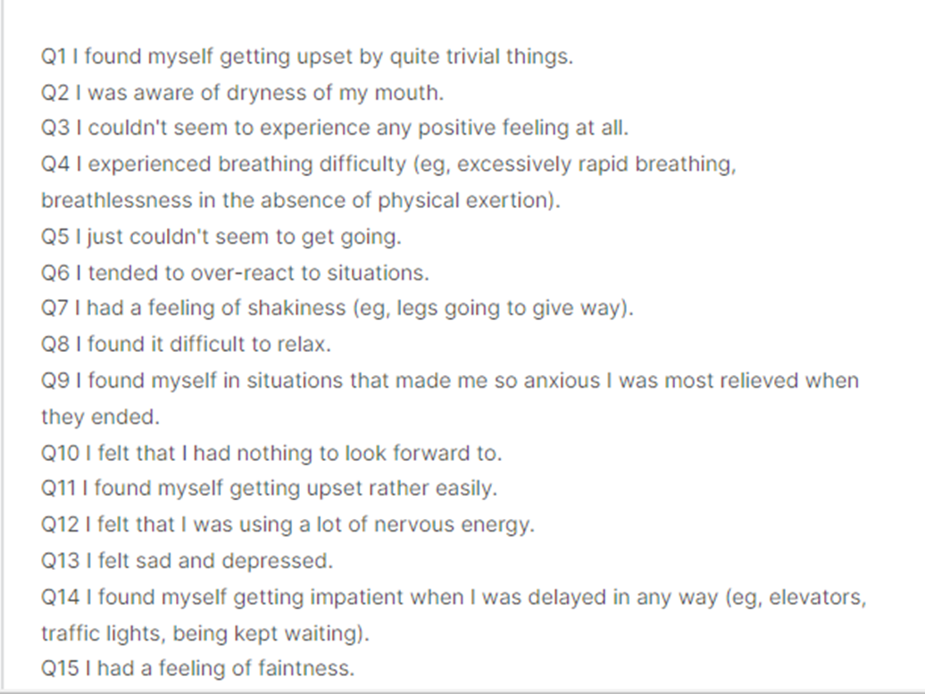
DATASET

Slide 5
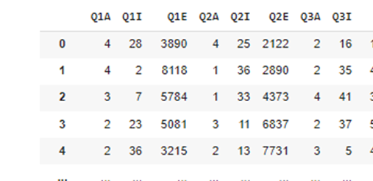
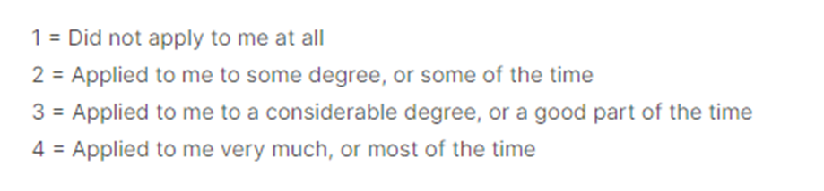
PROJECT FLOW : DATASET DESCRIPTION
A
This response is stored in variable A (1,2,3,4)
I
question's position in the survey
Earth is the third planet from the Sun and the one where we live on
E
the time taken in milliseconds to answer that question
Saturn is the ringed one. It’s composed mostly of hydrogen and helium
It’s a gas giant and the biggest planet in the Solar System

Slide 6
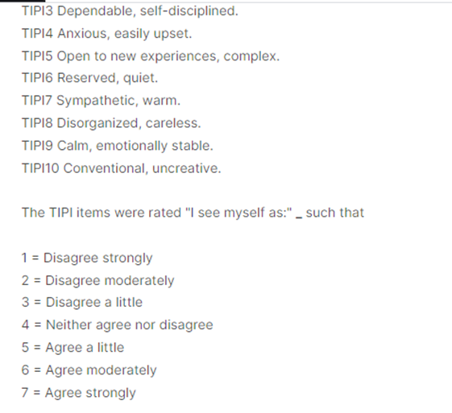
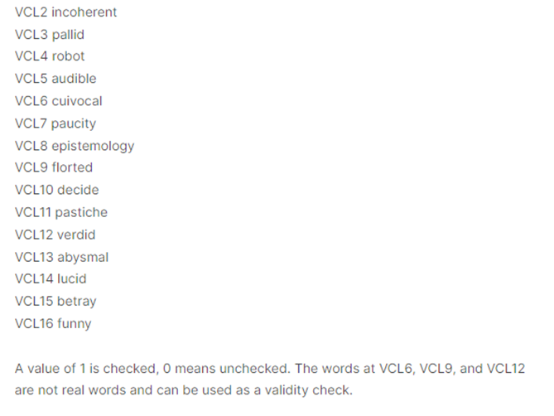
Mars is a cold place

Slide 7
Libraries Used:
Numpy
Matplotlib
Numpy is one of the most commonly used packages for scientific computing in Python.
Matplotlib is a cross-platform, data visualization and graphical plotting library for Python.
Pandas
Seaborn
Pandas is mainly used for data analysis. Pandas allows importing data from various file formats
Visualization is the central part of Seaborn which helps in exploration and understanding of data.

Slide 8
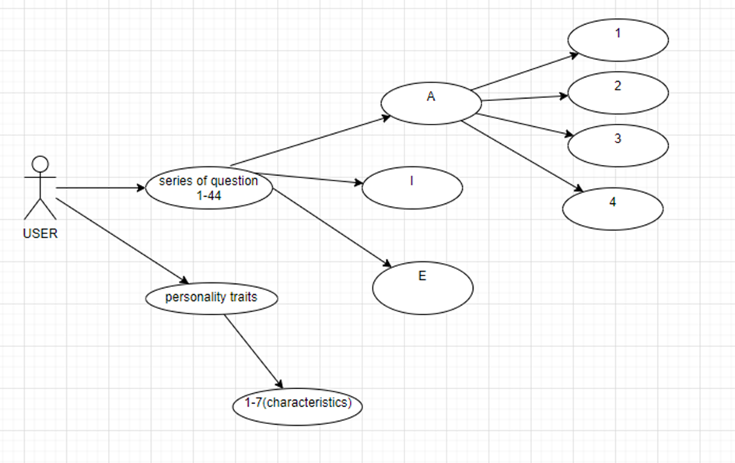
Use Case Diagram :

Slide 9
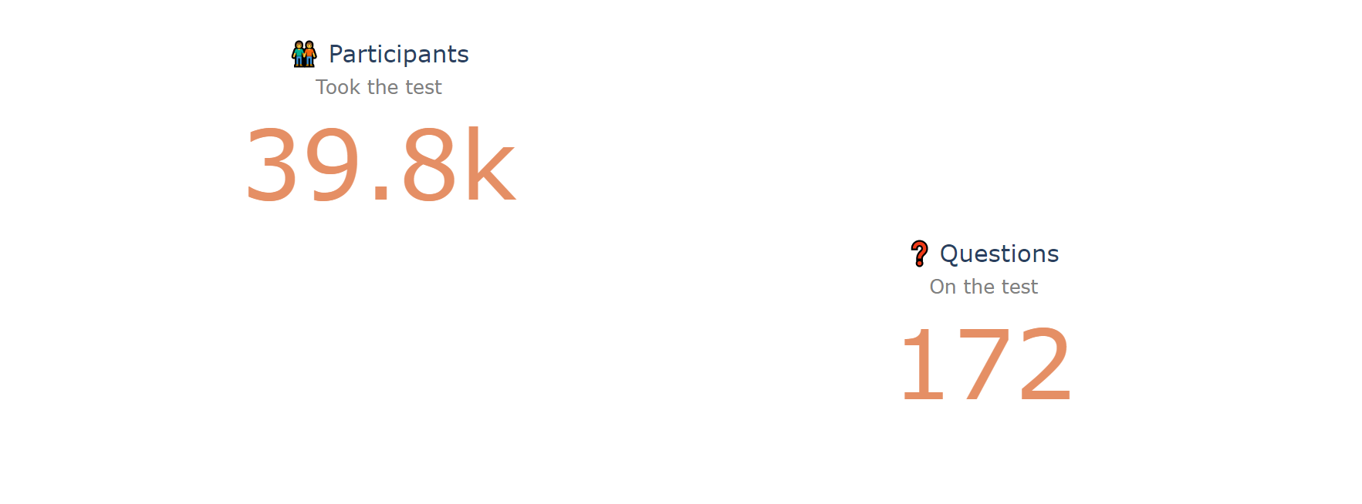
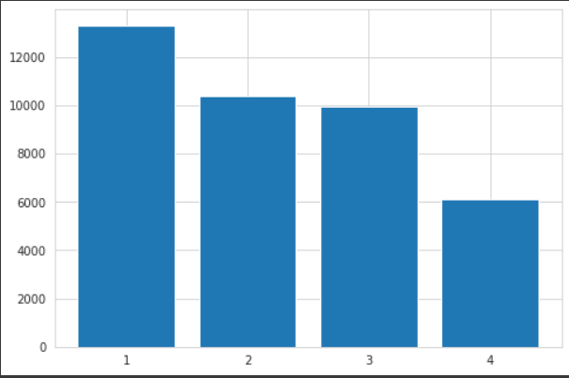
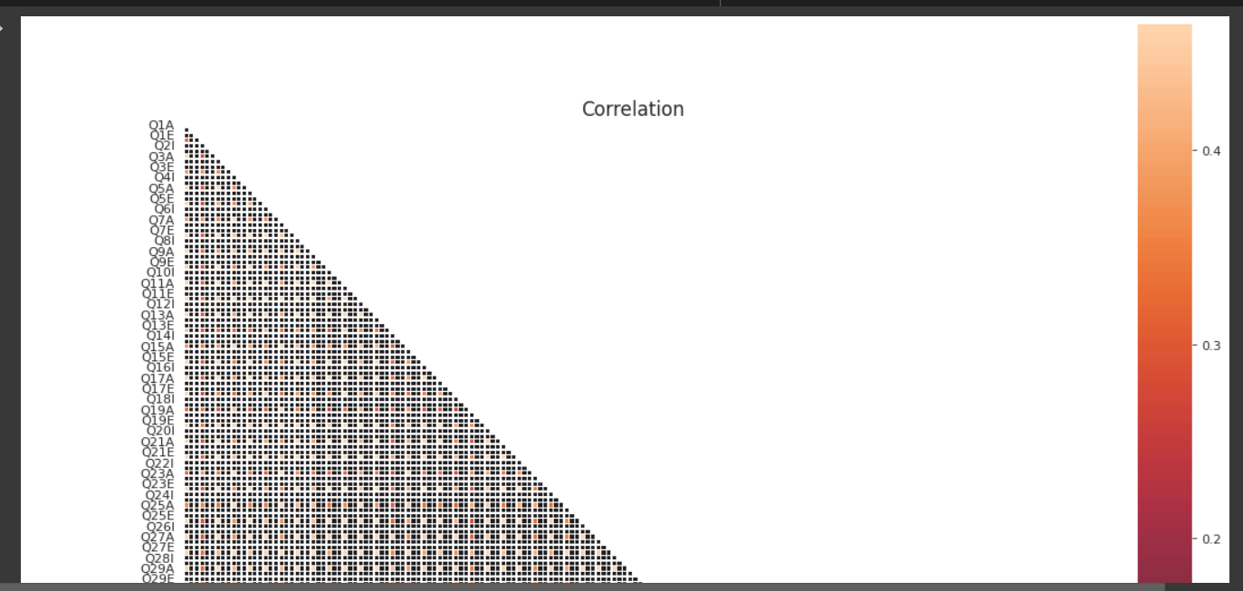
Screens:

Slide 10
THANK YOU

